Slide 1






WATERSEC
SMART WATER METER MONITORING
1

Slide 2


TABLE OF CONTENTS :
01
Introduction
02
Problem Statement
03
Proposed Solution
04
Alignment with the SDGs
05
Market Opportunity
06
Business Model
07
Competitive Advantage
08
Flyer and Poster
09
Conclusion
2

Slide 3
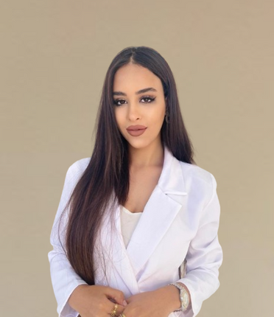






OUR TEAM
Loujein bousnina
Firas ghrarai
adem somai
Sirine Chaabi
Molka Ben Ammar
Safwen werghi
Bader zitouni

Slide 4
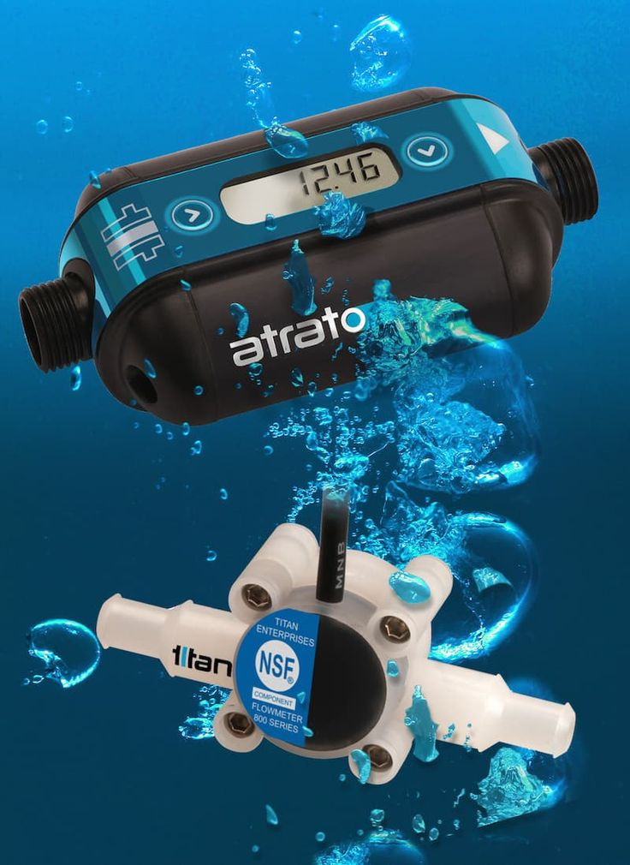
WSSM IOT SYSTEM: SMART WATER METER MONITORING
A Collaborative Project with [WaterSec]
WATER SEC
4

Slide 5

INTRODUCTION
5

Slide 6

Introduction
Current Problems:
Traditional water monitoring is not very effective, which causes a lot of wasted resources and adds extra pressure on the system."
WSSM’s Solution:
Our project uses IoT and AI to improve how we monitor, manage, and save water."
Let me know if you’d like a version with more technical or formal language.
Urgent Need:
Big water problems like shortages and climate change require quick and smart ways to manage water."
6

Slide 7


Problem Statement
Deep Inefficiencies.
Costly Leaks.
High Maintenance Costs.
IoT Limits.
Siloed Efforts.
WATERSEC
7

Slide 8

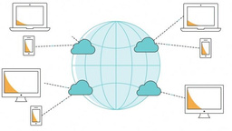



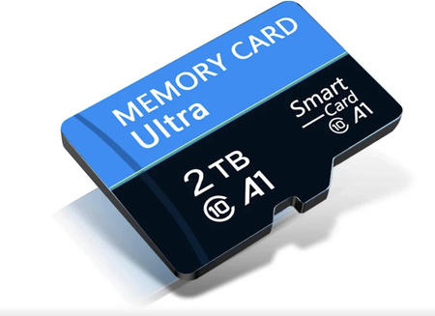

Solution
Revolutionary Platform.
Real-Time Data & AI.
Integrated User Access.
Proactive Maintenance.
Flexible & Scalable.
8
Real-time monitoring, even offline.
WATERSEC

Slide 9
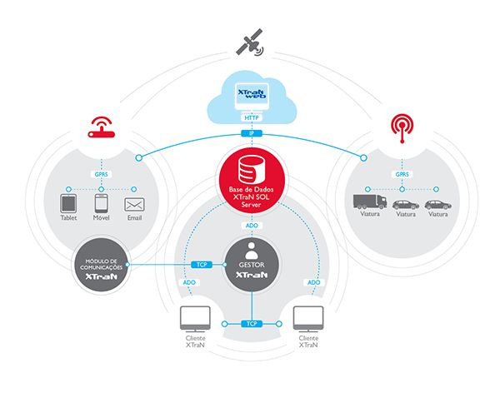
I O T
A R C H I T E C T U R E
9

Slide 10
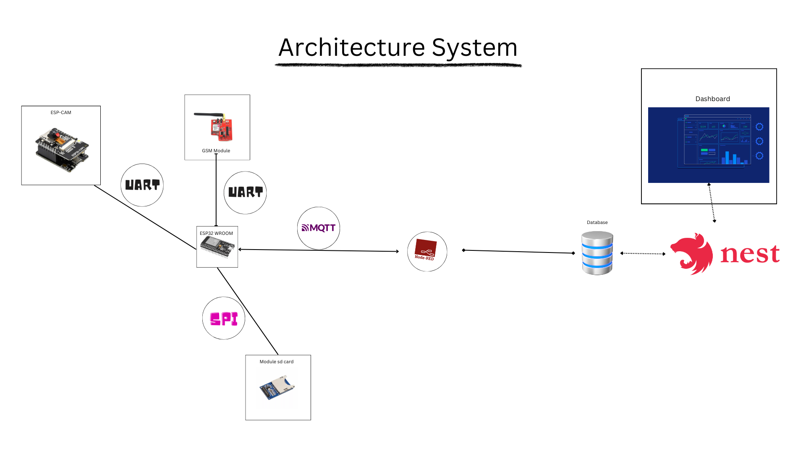
10
Water Sec

Slide 11


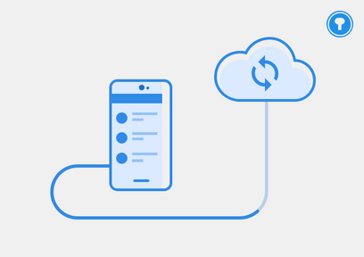
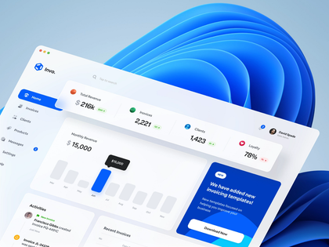
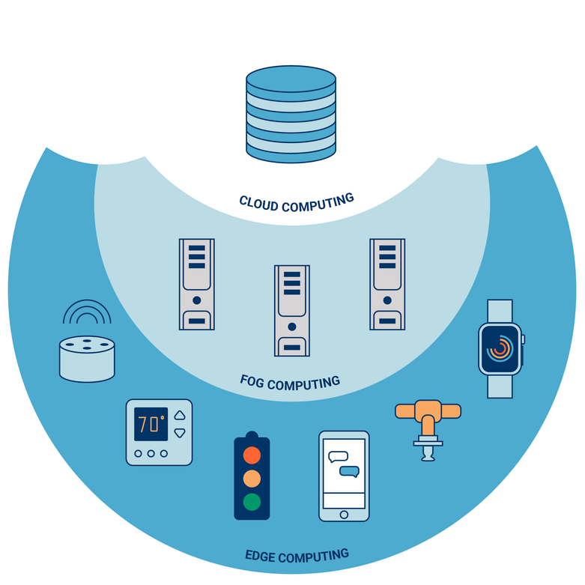

Functional scenarios :
Real-Time Data Acquisition & Edge Processing
User Notification & Dashboard Visualization
Secure Local Data Transmission
On-Premises Analytics &
Alert Generation
11

Slide 12


Alignment
with the SDGs :
SDG 13 : Climate Action
SDG 12 : Responsible Consumption & Production
SDG 6 : Clean Water &
Sanitation
12
Notes:
Bader

Slide 13

MARKET
Opportunity
13
Notes:
Bader

Slide 14


Target audience :
Residential like homeowners
Agricultural Sector like farmers
Municipal & Utility Providers
Industrial Users
14
Notes:
Our system ensures efficient data collection and communication. Every 10 minutes, the camera captures images of the water meter. Edge AI then extracts and validates the readings. If the device is offline, data is temporarily stored locally and later synced to the cloud via MQTT, ensuring reliable and continuous data transmission

Slide 15
MARKET SIZE &
O P P O R T U N I T Y
01
Critical Need (water scarcity)
02
Significant Losses (over consumption)
03
Growing Demand (IoT-based solutions)
04
Untapped Potential (cost effective)
15

Slide 16



Type of Service :
B2B ( Business to Business) : for agricultural and industrial clients.
B2G (Business-to-Government): Partnering with municipalities and public water utilities.
A WATER DRIVE
16

Slide 17









Designed for:
Date:
Version:
The Buisness Model Canvas :
WSSM
18/05/2025
Modéle N°1
Component Suppliers (ESP32, sensors, etc.)
Central Database ( MongoDB)
LoRaWAN Network Providers (if applicable)
Local government agencies / Agricultural bodies
R&D (Hardware, Software, AI Models)
Manufacturing & Assembly (or sourcing)
Platform Development & Maintenance
Sales, Marketing & Customer Support
Reduced water waste & cost savings (bills, maintenance).
Real-time insights & early leak/contamination detection.
Predictive maintenance & enhanced operational efficiency.
Environmental compliance & sustainable resource management.
Self-Service (App/Web)
Dedicated Support (Enterprise)
Community Forums
Homeowners (Residential)
Agricultural Sector (Farmers, Agri-businesses)
Municipal Water Utilities & Public Sector
Industrial Users
Key Partnerships
Key Activities
Value Propositions
Customer Relationships
Customer Segments
Proprietary IP (AI algorithms, software)
Hardware designs (Custom PCB)
Technical Team (Engineers, Data Scientists)
Mobile App (Flutter) & Web Platform (Direct-to-User)
Direct Sales & Partnerships (for B2B/B2G)
Local Installers / Distributors
Key Resources
Channels
R&D, Hardware (COGS)
Software Licenses
Salaries, Marketing & Sales
Operations & Support
Hardware sales/lease of WSSM units.
Tied software/data subscription fees.
Advanced analytics & reporting services.
Customization & integration services.
Cost Structure
Revenue Streams
17

Slide 18


4P Analysis
Product: Integrated WSSM system: Hardware (ESP32, PCB) & Software (Edge AI, Mobile/Web Apps)
Price: Cost-Effective Strategy, Potential one-time hardware purchase
Promotion: Digital Marketing, Industry Engagement, Pilot Programs & Case Studies
Place: Direct sales for B2B (agricultural, industrial) and B2G (municipalities) clients
18

Slide 19

Competitive Advantage
AI-Driven Multi-Parameter Intelligence
Cost-Effective & Scalable Solution
Comprehensive User Platform
Advanced Technology & Resilience (Edge AI & SD card)
Local Adaptation & Compliance
19

Slide 20



Mark eting
20

Slide 21



Flyer & Poster :
Our flyer and poster is a welcoming space that fosters growth, innovation, and collaboration, where every idea can flourish.
21

Slide 22


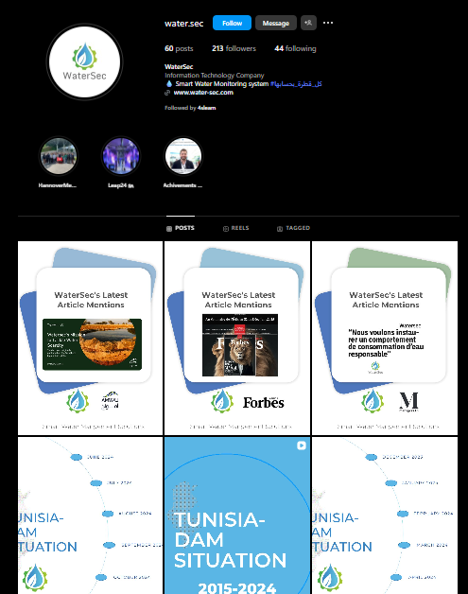

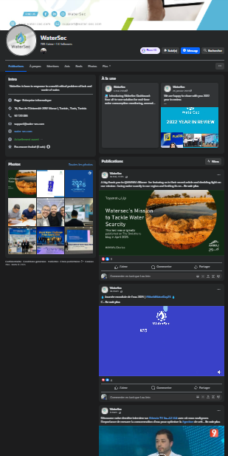

FACEB K page :
22

Slide 23

Successfully integrates IoT/AI to tackle water scarcity with a cost-effective, scalable, and adaptable solution offering real-time & predictive insights.
Empowers users, aligns with SDGs, and actively contributes to a resilient, water-secure future.
Future Potential Holds exciting promise for continued innovation in water management.
WaterSec
23
Contact: [support@water-sec.com] | [WaterSec]"
Notes:
The WSSM system revolutionizes water meter monitoring with IoT, Edge AI, and cloud integration, ensuring reliable, real-time data with 60% less loss. Our next steps include leak detection, predictive maintenance, and LoRaWAN expansion.

Slide 24


24

Slide 25



Thank you !
https://www.facebook.com/search/top?q=watersec
https://www.instagram.com/water.sec/?hl=fr
25

